Slide 1


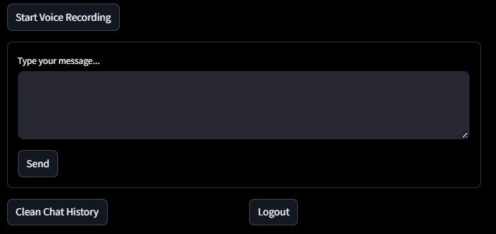
Samadhan 2.0
National Level Hackathon On
AI In Education
(Where preparation meets personalization.)
>
Logout.
SWA DESH
SWADESH
Hello! I'm Swadesh.
How can I assist you today?
Study smarter with Swadesh – simple, personal, bilingual. ” when study meets with smartness. An ai chatbot to guide and mentor you in your learning.
🎙 Speak to Swadesh
Team Name : Bracket Breakers
Team Leader : Arpita Sharma (Project Manager)
Team mate: Kaushal Dhakad (Technical Lead)
Organizers :
SISTEC
CALM CHASE
IBOTIX
MARKTINE
Collage : Sagar Institute Of Science And Technology (SISTEC)
www.samadhan.sistec.ac.in/

Slide 2






Our Inspiration
As students want a personalized study tool that adapts to our unique learning style.
An all-in-one platform with PYQs, mock tests and questions to make time management
Tired of juggling notes, PYQs, and mock tests across multiple apps & websites.
A fun study tool with our language, games, and voice commands.
A single hub for all notifications that keeps us consistent. About our
Routine
Rural area students who have lack of guidance and coachings..
01
02
03
04
05
06

Slide 3




1. Problem Identification – Analyzing student struggles (scattered content, high fees, language barriers).
2. Research & Feedback – Collecting insights from real aspirants & educators.
5. AI-Personalization – Adaptive learning paths, voice chat, and smart recommendation
6. Gamification & Motivation – Quizzes, streaks & rewards to keep consistency.
Approach
and methodology
3. Design Thinking – Creating a user-friendly, bilingual & exam-focused platform.
4. Integration – Bringing notes, PYQs, mock tests, doubt-solving & progress tracking into one app.
7. Testing & Iteration – Pilot launch, student feedback, continuous improvement. 8. Scalability & Expansion – Adding more exams, skills & regional languages

Slide 5
Problem statement
4
Language barriers make learning harder for non-English medium students..
3
5
Time is wasted searching for accurate study material online. By covering websites.
Lack of guidance and less availability of study materials for competitive exams
2
6
Rural learners lack access to quality teachers, coaching, and updated resources.
Scholarship and Government schemes guidance for various categories.
1
7
Existing learning feels boring killing consistency motivation
Immediate access to expert guidance when doubts arise

Slide 6
Proposed solutions
7
Instant Doubt-Solve – 24×7 expert/AI assistance whenever needed.
6
Scholarship Info – Easy access to schemes & opportunities for all categories.
Smart AI Guidance – Simplifies complex concepts for college students.
1
5
Exam Ready Tools – Offers mocks, PYQs & expert guidance for competitive exams.
2
Digital Access – Brings quality teachers, notes & resources to rural learners.
4
Bilingual Support – Breaks language barriers for non-English learners.
3
Central Hub – Saves time with all study material in one platform.

Slide 7

1
3
Everything about competitive exam
AI-driven platform providing everything about competitive exams – from syllabus and study plans to practice tests and progress tracking.
Progress Report /
Time table maker
AI-powered tool for generating detailed progress reports and creating smart, personalized timetables.
FEATURES
2
4
Career Guidance and vacancies
AI-powered career guidance for smart, personalized choices.
24/7 availability instant doubt solving
24/7 AI assistant for instant doubt solving and continuous learning.

Slide 8
Integrated MCP Learning – Seamless access to notes, PYQs & mocks in one hub.
Personalized Timetable – Adaptive scheduling for effective prep.
Bilingual Voice Chat – Instant AI mentor in English & regional languages.
1
3
5
2
Usp
6
4
Smart Progress Tracker – AI analytics to monitor growth & weak areas.
Affordable & Inclusive – Low-cost plans with scholarship guidance.
Mind Refresh Tools – Relaxation games & activities to reduce stress

Slide 9





Accessibility and exam readiness
Productivity and efficiency future
Inclusivity and engagement in studies
Expected outcome
Innovation and scalability
Affordability and advancement of future
Growth and developments
Consistency and mentorship for betterment
Personalized guide to make learning Smart

Slide 10
✅ 1. Framework & Technology → Built in Python with Streamlit for both frontend & backend. → No external server needed — everything runs in a single script.
Backend stack used
✅ 3. Notes Handling Logic → Notes are stored in memory as a Python list (st.session_state. Notes). Users can: → Add new notes appended to the list. –Delete specific notes → removed by index. → A static Google Drive button provides permanent storage access.
✅ 2. Session State Management → Uses st.session_state to store: page → Tracks which page (Chatbot, Notes, Game, etc.) the user is on. Notes → Stores all notes temporarily during the session.
→ This ensures smooth navigation without losing data.
✅ 4. Page Navigation & Integration → Navigation is handled through conditional rendering: → No reload required; Streamlit dynamically updates the UI.

Slide 11
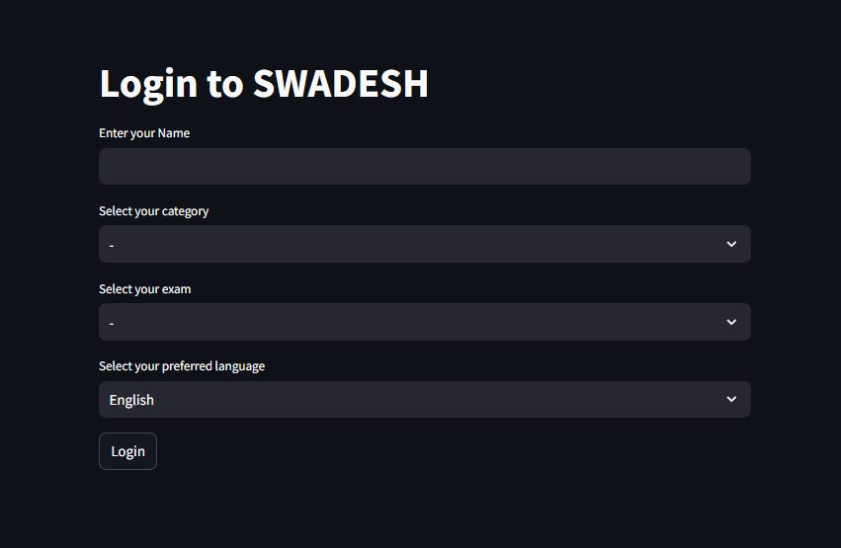
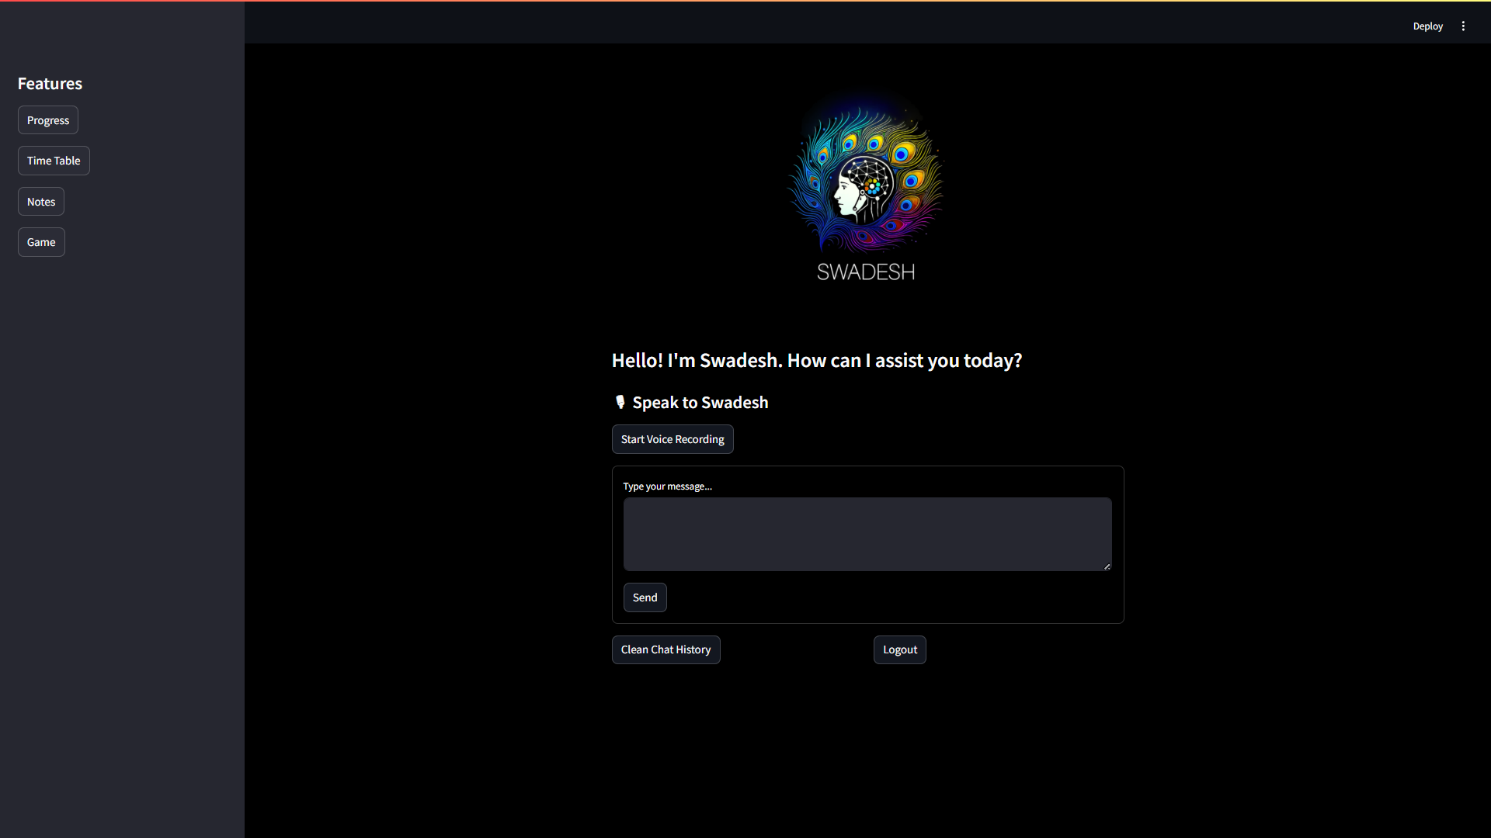
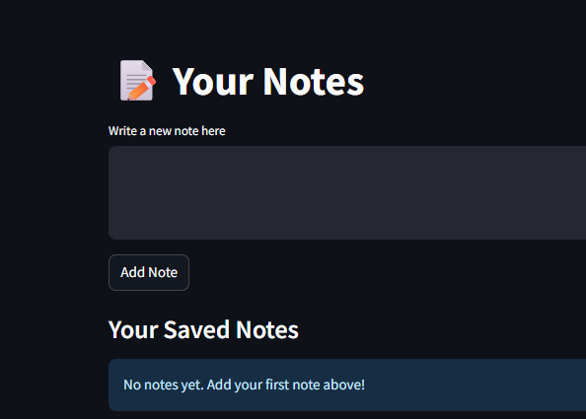
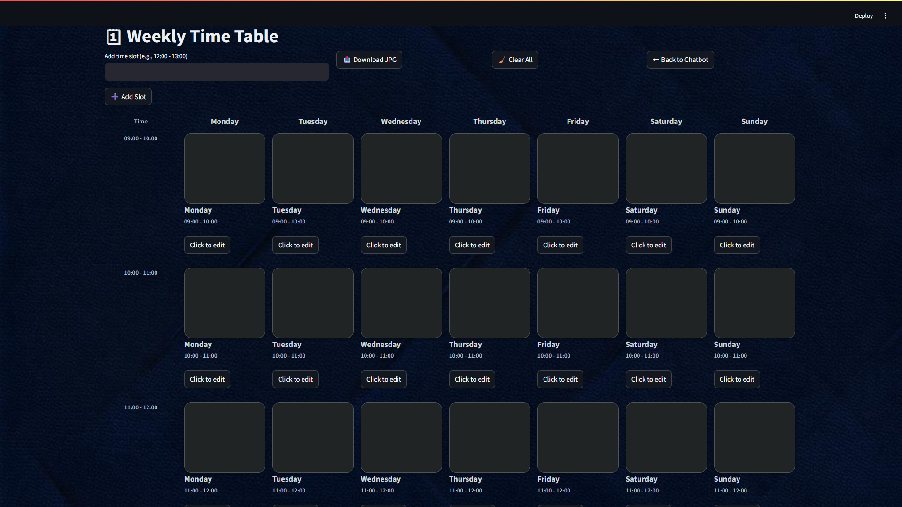
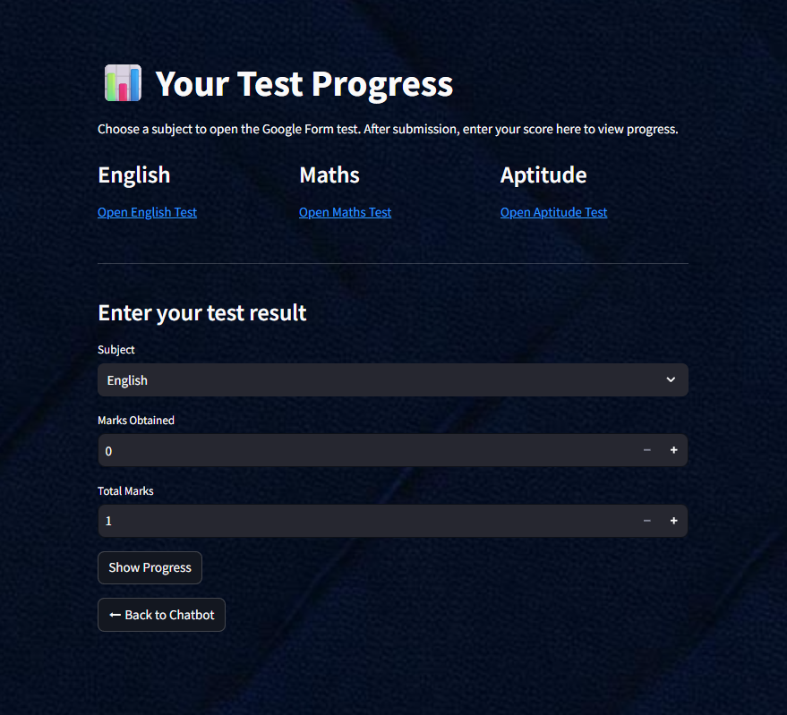


Frontend
Interface
Time Table
Notes
Chatbot
Login Page
Game
Progress

Slide 12
Time Table
Notes
Chatbot
Login Page
Game
Progress
Frontend
Interface

Slide 13
Extra plus feature
State wise government schemes for students with eligibility and documents required
State wise facilities available for students with eligibility and documents required
State-wise Student Facilities
Government Schemes
01
Jobs & Reservations
Caste and State wise scholarship for students with eligibility and documents required
02
Scholarships
Jobs and reservation available for youngster along with case and eligibility and documents required
03
04

Slide 14
1
Pan-India Reach – Regional languages + bilingual support for Tier-2 & Tier-3 students
2
Feature Enrichment – AI mentor, mock tests, gamified learning & personalized progress.
Growth and expansion
Strategic Partnerships – Tie-ups with institutes, coaching centers & edtech platforms.
3
4
Global Vision – From India’s AI tutor to a worldwide exam & skills mentor.

Slide 16
Certification
Skill Certificates – Award completion badges for short courses.
Exam Prep Certificates – Offer mock test completion proof for competitive exams.
Industry-Recognized – Partner with companies to make certifications job-relevant.
Advertising
Targeted Ads – Show only subject-relevant ads (books, courses, tools).
Sponsored Content – Let institutes promote webinars or workshops.
Partnership Campaigns – Collaborate with EdTech brands for joint promotions.
2
4
1
3
Future Planning
0–6 Months – Launch MVP, test with pilot users, start social media.
6–18 Months – Add features, partner with institutions, start free model.
18+ Months – Go multilingual, launch AI tutors, expand globally.
Business Ideas
Subscriptions – Paid premium learning tools.
Licensing – Sell to schools/colleges.
Affiliate Sales – Partner with courses/books.
Upskilling – Add career-focused courses.
Analytics – Sell learning insights to institution

